Slide 1
REKAYASA PERANGKAT LUNAK
Siklus Hidup Perangkat Lunak
(Software Lifecycle )
&
Model Proses PL
(Software Process Models )

Slide 2
Deskripsi
Menjelaskan siklus hidup PL
Menjelaskan model proses PL
IF 1483 - RPL TEKNIK INFORMATIKA
UPN “VETERAN” YK

Slide 3
Tujuan Instruksional Umum
(TIU)
Mahasiswa mampu menjelaskan konsep Siklus hidup perangkat lunak
Mahasiswa mampu menjelaskan model proses pembangunan perangkat lunak
IF 1483 - RPL TEKNIK INFORMATIKA
UPN “VETERAN” YK

Slide 4
Software Engineering / RPL
Layered Technology
  Key Process Areas
Menyediakan tools utk membangun sw
Bgmn membangun SW
Tools
Kerangka kerja
Methods
SE focus pada quality
Process
Quality
[Pressman 97]
IF 1483 - RPL TEKNIK INFORMATIKA
UPN “VETERAN” YK
Notes:
Engineering needs organizational commitment to quality
TQM, et al, continuous process improvement culture
Leads to more mature approaches to software engineering
Process
Foundation
Glue that holds the technology layers together
Framework for Key Process Areas
KPAs
must be established for effective delivery of software technology
Basis for management control of software projects
Context:
technical methods applied
work products are produced
milestones established
quality assured
change managed
Methods
Technical “how-to’s”
Tools
Automated or semi-automated support for process or method

Slide 5
Software Quality
Critical Quality Attributes
[Sommerville 96]
  Maintainability
  Dependability
  Efficiency
  Usability
Other Attributes
  Completeness
  Compatibility
  Portability
  Internationalization
  Understandability
  Scalability
  Robustness
  Testability
  Reusability
  Customizability
IF 1483 - RPL TEKNIK INFORMATIKA
UPN “VETERAN” YK
Notes:
Definition of Critical Attributes:
Maintainability - possible to evolve software to meet changing needs
Dependability - includes range of characteristics: reliability, security and safety; should not cause physical or economic damage in the event of system failure
Efficiency - should not make wasteful use of system resources such as memory and process cycles
Usability - should have appropriate user interface and adequate documentation
Other Attributes:
Safety
Security
Reliability
Resilience
Robustness
Understandability
Testability
Adaptability
Modularity
Complexity
Portability
Reusability
Learnability

Slide 6
Capability Maturity Model
Dikembangkan oleh Software Engineering Institute (SEI)
Untuk mengetahui level kemampuan perusahaan pengembang S/W
Lima Level Process Maturity
  Level 0: Chaos, kacau
  Level 1: Initial
    dikerjakan secara khusus, kadang masih kacau , keberhasilan project ditentukan oleh usaha individu
  Level 2: Repeatable,
    proses manajemen project sudah ada untuk melacak beaya, jadwal, fungsi,
    keberhasilan project sebelumnya bisa diterapkan pada project lain yang mirip
IF 1483 - RPL TEKNIK INFORMATIKA
UPN “VETERAN” YK
Notes:
Emphasis on Process Maturity
Provides a measure of global effectiveness of a company’s software engineering practices
Level 0:
Level 1: ad hoc, occasionally chaotic; few defined processes and success depends on individual effort
Level 2: Repeatable: basic PM processes are established to track cost, schedule, and functionality. Necessary process discipline is in place to repeat earlier successes on projects with similar applications
(configuration MGT, SQA, subcontract MGT, project planning, tracking & oversight, Requirements MGT)
Level 3: process for management and engineering is documented, standardized, and integrated into an organization wide software process; all projects use a documented and approved version of the organization’s process for development and maintenance
(Peer reviews, intergroup coordination, software product engineering, integrated software MGT, training program, organization process definition, organization process focus)
Level 4: detailed measures of software process and quality are collected; both process and products are quantitatively understood and controlled using detailed measures
(Software quality MGT, quantitative process MGT)
Level 5: continuous process improvement is enabled by quantitative feedback from the process and from testing innovative ideas and technologies.
(Process change MGT, technology change MGT, defect prevention)

Slide 7
CMM (lanjutan)
  Level 3: Defined
    Proses manajement dan aktifitas rekayasa sudah terdokumentasi, terstandarisasi dan terintegrasi pada organisasi pengembangan software.
    Termasuk seluruh karakteristik di level 2
  Level 4: Managed :
    Detil measurement/pengukuran dari proses sw dan kualitas product dikumpulkan
    Termasuk seluruh karakteristik di level 3
  Level 5: Optimizing
    Pengembangan proses yang berkelanjutan dengan memanfaatkan feedback dari proses , testingyang telah dilakukan
    Termasuk seluruh karakteristik di level 4
IF 1483 - RPL TEKNIK INFORMATIKA
UPN “VETERAN” YK

Slide 8
Prinsip-Prinsip Proses
Menentukan seluruh aktivitas utama
Menggunakan sumber daya, dengan batasan tertentu, untuk menghasilkan produk antara dan produk akhir
Tersusun dari beberapa sub proses
Setiap aktivitas mempunyai kriteria masukan dan keluaran
Aktivitas diorganisasikan secara teratur
Mempunyai panduan yang menjelaskan tujuan
Aturan dipakai pada aktivitas,sumberdaya & produk
IF 1483 - RPL TEKNIK INFORMATIKA
UPN “VETERAN” YK
Notes:
Definition of Process: a series of steps involving activities, constraints, and resources that produce an intended output of some kind
Process Attributes:
Understandability - To what extent is the process explicitly defined and how easy is it to understand?
Visibility - Do the process activities culminate in clear results so that the progress of the process is externally visible?
Supportability - To what extent can the process activities be supported by CASE tools?
Acceptability - acceptable and usable by engineers?
Reliability - Is the process designed in such a way that process errors are avoided or trapped before they result in product errors?
Robustness - Can the process continue in spite of unexpected problems?
Maintainability - Can the process evolve to reflect changing organizational requirements or identified process improvements?
Rapidity - How fast can the process of delivering a system from given specification be completed?

Slide 9
Tahapan Pengembangan PL Software Development Stages
Requirements Analysis & Specification
Conceptual/System Design
Detailed/Program Design
Implementation/Coding
Unit & Integration Testing
System Testing
System Delivery
Maintenance
IF 1483 - RPL TEKNIK INFORMATIKA
UPN “VETERAN” YK
Notes:
Requirements analysis & specification
Conceptual/System design
Detailed/Program design
Coding/Implementation
Unit Testing & Integration
System Testing
System Delivery
Maintenance

Slide 10
Model Siklus Hidup PL
Software Lifecycle Models
Waterfall Model
V Model
Prototyping Model
Operational Specification Model
Phased Development Model
Spiral Model
IF 1483 - RPL TEKNIK INFORMATIKA
UPN “VETERAN” YK

Slide 11
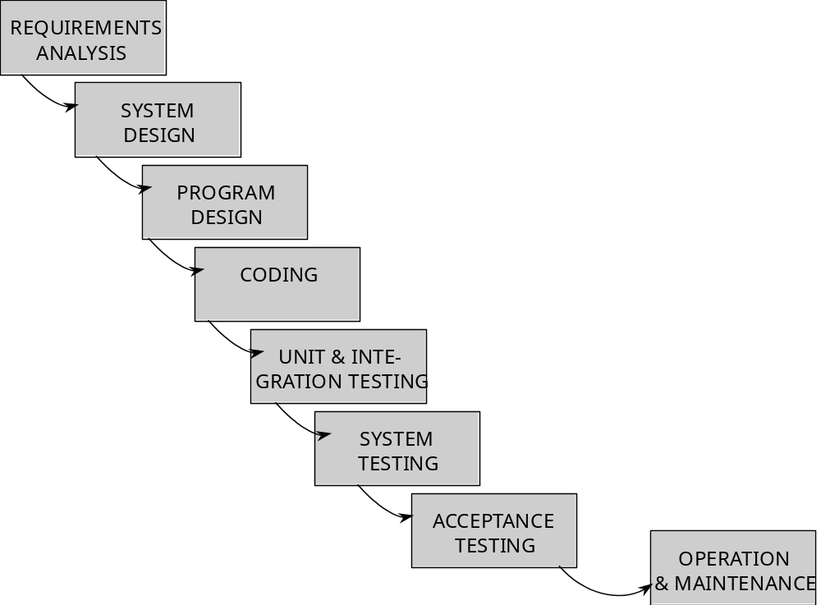
Waterfall Model
[Pfleeger 98]
IF 1483 - RPL TEKNIK INFORMATIKA
UPN “VETERAN” YK
Notes:
[Royce 1970] - DoD contracts
PROS:
Focuses attention
Easy to explain to customers
Intermediate products are made explicit
CONS:
Does not really reflect how software is produced
Imposes PM structure - no explanation of how artifact from one stage is transformed in the next
Failure to treat software as problem-solving process

Slide 12
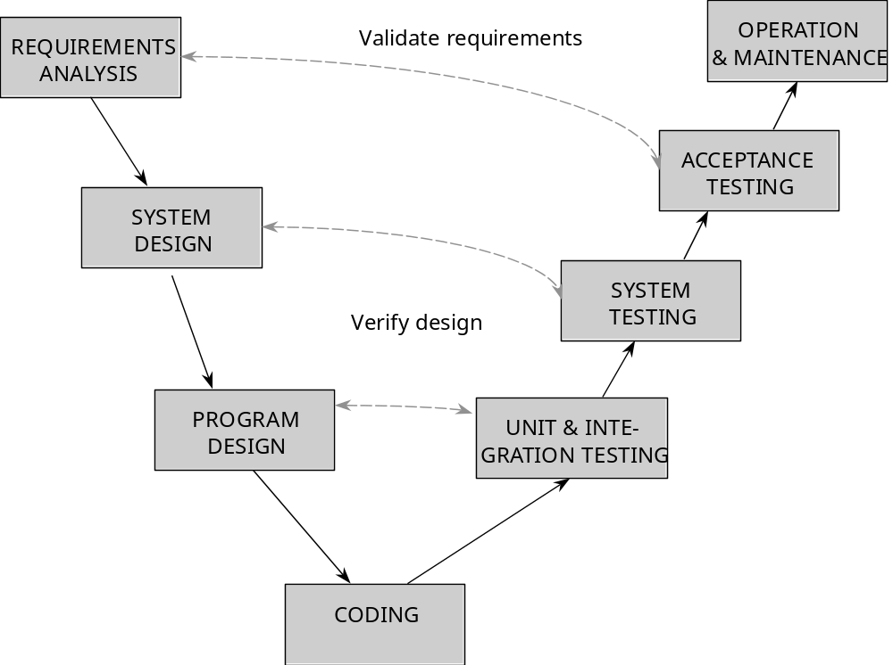
V Model
[Pfleeger 98]
IF 1483 - RPL TEKNIK INFORMATIKA
UPN “VETERAN” YK
Notes:
[German Ministry of Defense 1992]
Variation that shows how testing activities relate to analysis and design
Makes more explicit the iteration and rework that are hidden in waterfall

Slide 13
Prototyping Model
Listen to
Customer
Build/Revise
Mock-Up
Customer
Test-drives
Mock-up
[Pressman 97]
IF 1483 - RPL TEKNIK INFORMATIKA
UPN “VETERAN” YK

Slide 14
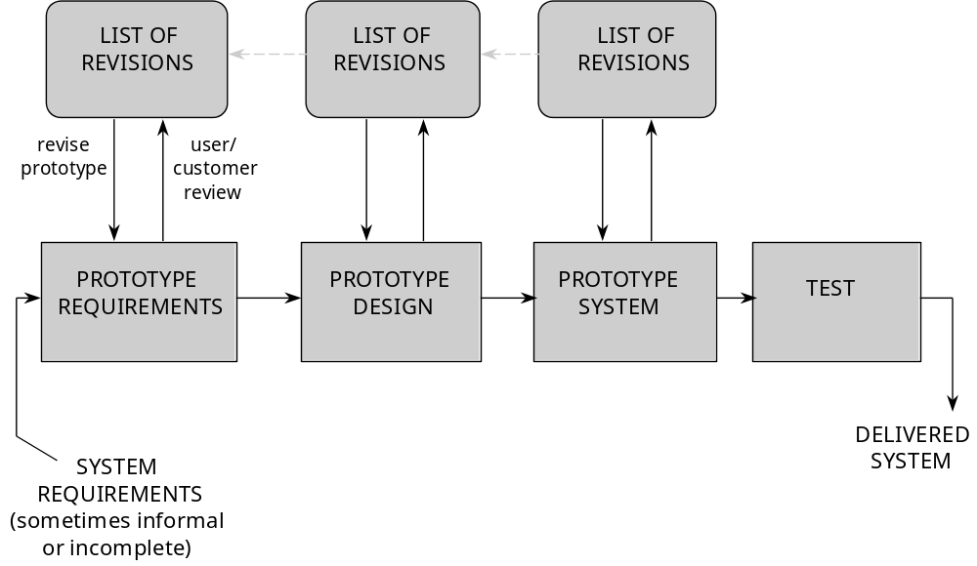
Prototyping Model
[Pfleeger 98]
IF 1483 - RPL TEKNIK INFORMATIKA
UPN “VETERAN” YK
Notes:
All or part of a system constructed quickly to understand or clarify issues
Overall goal: reducing risk and uncertainty in development
Explore alternative designs

Slide 15
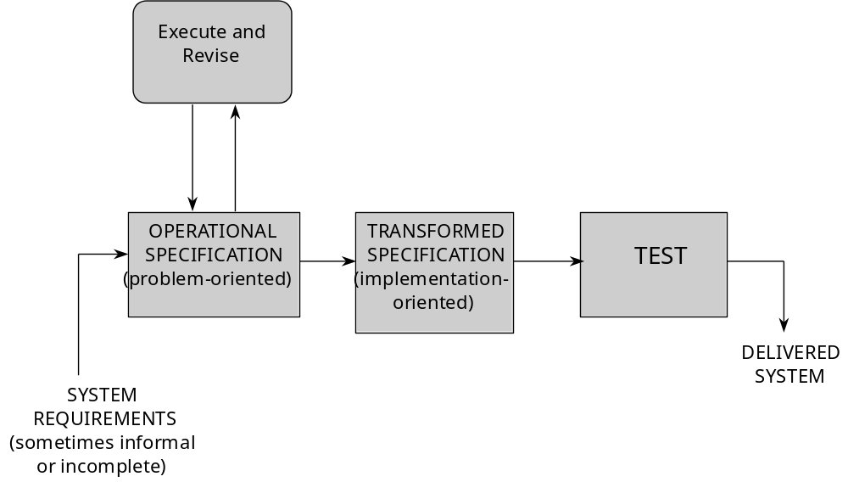
Operational Specification Model
[Pfleeger 98]
IF 1483 - RPL TEKNIK INFORMATIKA
UPN “VETERAN” YK
Notes:
System requirements are evaluated/executed in a way that demonstrated behavior of a system
Full specification that can then be enacted using a automated software tool
Merges functionality with design

Slide 16
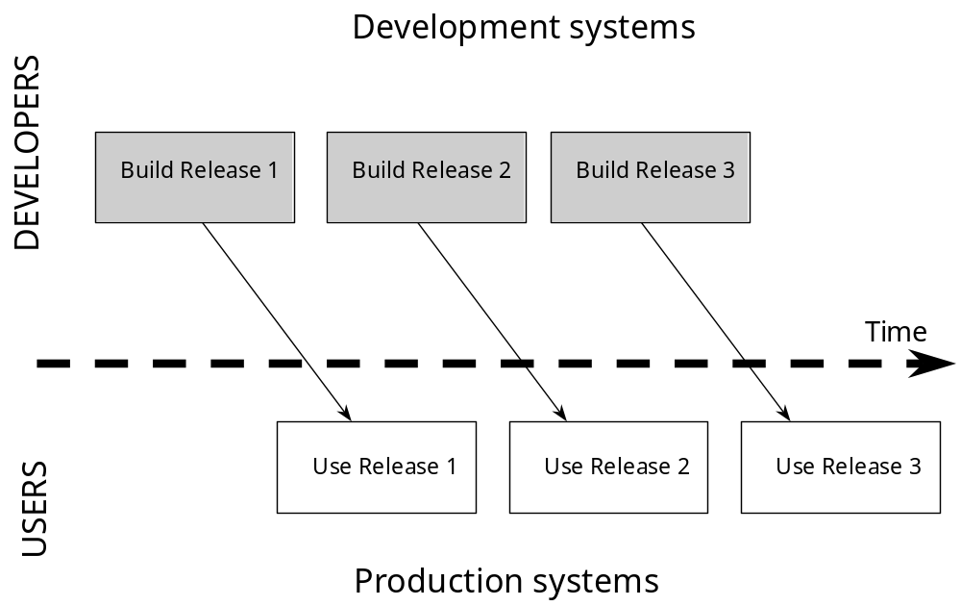
Phased Development Model
[Pfleeger 98]
IF 1483 - RPL TEKNIK INFORMATIKA
UPN “VETERAN” YK
Notes:
Iterative vs. Incremental Development
Iterative - full system at beginning, changes functionality with each release
Incremental - subsystems are added & functionality builds with each release
ADVANTAGES:
Early training on early release
Create markets for non-existing functionality
Bundle patches in with frequent releases
Development team can focus on different areas with each release

Slide 17
Boehm’s Spiral Model
DETERMINE GOALS,
EVALUATE ALTERNATIVES
ALTERNATIVES,
AND RISKS
CONSTRAINTS
Constraints
4
Risk analysis
[Pfleeger 98]
4
4
Constraints
3
Risk analysis
3
Alternatives
3
Constraints
2
Risk analysis
Alternatives
2
2
Alternatives
Risk analysis
Constraints
1
Proto
-
Proto
-
Proto
-
Budget
4
Budget
3
Budget
2
Budget
Alternatives
1
Prototype
1
type
2
type
3
type
4
start
1
1
Requirements,
Concept of
Detailed
life-cycle plan
operation
Software
design
Software
design
requirements
Integration
Development
Validated
Code
and test plan
plan
requirements
Validated,
verified design
Unit test
System
Implementation
Acceptance
test
PLAN
plan
test
DEVELOP AND TEST
IF 1483 - RPL TEKNIK INFORMATIKA
UPN “VETERAN” YK
Notes:
[Boehm 88]
Viewed in light of risks involved
Combine development with risk MGT

Slide 18
Ringkasan Materi
Layer Teknologi
Software Quality
Tahapan Pengembangan PL
Siklus Hidup Perangkat Lunak
IF 1483 - RPL TEKNIK INFORMATIKA
UPN “VETERAN” YK

Slide 19
Referensi
  Software Engineering: A Practitioner's Approach (Bab 4)
Pengarang : Roger S. Pressman
Penerbit: Fourth Edition, McGraw-Hill, 1997
IF 1483 - RPL TEKNIK INFORMATIKA
UPN “VETERAN” YK

